Slide 1
Decision Support Systems

Slide 2
Decision Support Systems
Decision support systems (DSS)
Offer potential to assist in solving both semi-structured and unstructured problems
Structured Problem:
Those in which the initial state, goal state, and constraints are clearly defined. E.g. solving WSPs requires procedural knowledge that follows a completely defined and step-by-step, or rote procedures

Slide 3
Unstructured Problems:
Are Novel and Infrequent in nature.
These types of problems may be difficult to recognize upon initial occurrence.
They may require specific analysis and research to fully understand.

Slide 4
Characteristics of a DSS (1)
Handles large amounts of data from different sources
Provides report and presentation flexibility
Offers both textual and graphical orientation

Slide 5
Characteristics of a DSS (2)
Supports drill down analysis
Performs complex, sophisticated analysis and comparisons using advanced software packages
Supports optimization, satisficing, and heuristic approaches

Slide 6
Characteristics of a DSS (3)
Performs different types of analyses
“What-if” analysis
Makes hypothetical changes to problem and observes impact on the results
Simulation
Duplicates features of a real system
Goal-seeking analysis
Determines problem data required for a given result

Slide 7
Types of DSS
Model Driven DSS
Model-driven DSSs are complex systems that help analyze decisions or choose between different options. These are used by managers and staff members of a business, or people who interact with the organization, for a number of purposes depending on how the model is set up - scheduling, decision analyses etc.
Data-Driven DSS
It is used to query a database or data warehouse to seek specific answers for specific purposes.

Slide 8
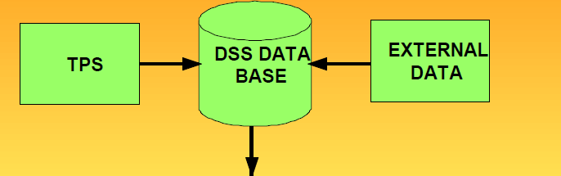
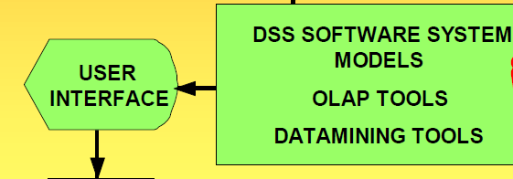
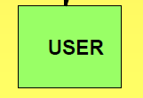
Components of DSS
DECISION SUPPORT SYSTEM

Slide 9
Components of DSS
DSS Database
A collection of current and historical data from a number of applications or groups.
DSS software system
Collection of software tools that are used for data analysis, such as OLAP tools,data mining tools, or a collection of mathematical and analytical models.
User interface
Permits interaction between user of the system and DSS software tools.

Slide 10
Decision support system
Geographic Information system
Software to display digital maps
• WEB-BASED DSS:
Available on Internet for decisions, information, software
CUSTOMER DSS (CDSS):
System supports buying decisions of customers

Slide 11
Group Decision support system
GROUP DECISION-SUPPORT SYSTEM(GDSS)
INTERACTIVE COMPUTER-BASED SYSTEM FACILITATES SOLUTION OF UNSTRUCTURED PROBLEMS BY DECISION MAKERS WORKING AS GROUP

Slide 12
Group Decision support system
GDSS ENHANCED DECISION MAKING
ALLOWS: Improved pre-planning
• Increased participation
• Open, collaborative atmosphere
• Idea generation free of criticism
• Evaluation objectivity
• Idea organization & evaluation

Slide 13
Group Decision support system
GDSS ENHANCED DECISION MAKING
ALLOWS: Setting priorities & decision making
Documentation of meetings
Access to external information
Preservation of organizational memory

Slide 14
Group Decision support system
TOOLS OF GDSS
• ELECTRONIC QUESTIONNAIRES
• ELECTRONIC BRAINSTORMING
• IDEA ORGANIZERS
• QUESTIONNAIRE TOOLS
• TOOLS FOR VOTING,

Slide 15
Group Decision support system
TOOLS OF GDSS
STAKEHOLDER IDENTIFICATION &ANALYSIS TOOLS
POLICY FORMATION TOOLS
GROUP DICTIONARIES

Slide 16
Group Decision support system
ELECTRONIC MEETING SYSTEM(EMS)
COLLABORATIVE GDSS: Uses information technology to make group meetings more productive facilitates communication decision making

